Slide 1
CBNAAT EQA KEY COMPONENTS, PLANS & ACTIVITIES

Slide 2
Contents
Key components of CBNAAT Quality Assurance programme
Contents of package to the sites
Plans
Activities and timelines
Summary

Slide 3
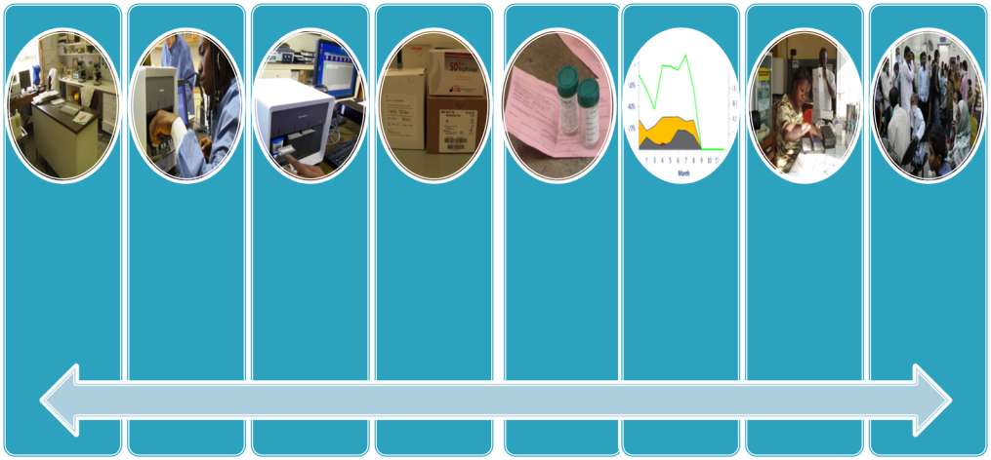
Key components of CBNAAT Quality Assurance program
Environment
- Safe and functional
- Temperature control
Personnel
- Trained and competent staff
- Test user is documented
- Current SOPs readily available
Equipment
- Maintained and serviced
Supplies
- Uninterrupted supplies
- Appropriate transport and storage conditions
Specimens
- Good quality
- unique ID
- Completed TRF
Internal quality monitoring
- Test working properly
External
Quality Assessment (EQA)
- Testing site‘s work checked by another site
Accurate and timely reporting
- Turnaround time
Results review
Accurate, reliable and timely results

Slide 4
What is Quality Assurance
Quality assurance (QA) in laboratories incorporates all the factors that may influence the generation of reliable results.
It comprises three key components.
Internal quality control (IQC)
External quality assessment (EQA)
Quality improvement (QI)

Slide 5
Quality Assurance (QA)
Encompasses a range of activities that enable laboratories to achieve & maintain high levels of accuracy & proficiency
QA seeks to guarantee the right result from
the right test
at the right time
on the right specimen
from the right patient
interpreted correctly

Slide 6
Components of Quality assurance
Internal quality control (IQC) : It’s a systematic internal monitoring of working practices, technical procedures, equipment and materials.
External quality assessment (EQA): A process to assess laboratory performance. This component is necessary to ensure comparability of results among laboratories.
Quality improvement (QI): Involves continued monitoring, identifying defects, followed by remedial action including retraining when needed, to prevent recurrence of problems.

Slide 7
Why External Quality Assessment (EQA)
EQA is also termed as proficiency testing and method to assess laboratory performance
EQA strongly contributes to continuous quality improvement of laboratory performance
Participating laboratories benefit because external quality assessment:
serves as an early warning system,
identifies systematic problems,
provides objective evidence of laboratory quality,
serves as an indicator for focusing improvement efforts,
identifies training needs,
provides a source for continuing education,
provides a source of materials for practice

Slide 8
Components of CBAAT EQA package to sites
5 Tubes of Panel and 5 pipettes
Processing SOP and Guidance documents
EQA Result Format

Slide 9
Plans
Manufacturing and
Panel Validation and verification
Packaging and shipment
Feedback report to the sites
Collection of site contact information (address/phone)
Collection, Compilation and data analysis
CBNAAT EQA sensitization meeting
Post EQA visits and report submission to CTD and states
Testing panel

Slide 10
Activities
Activity | Timelines
Panel Manufacturing | January 2020
Validation and Verification of stability | March 2020
Packaging | April 2020
EQA Sensitization Meeting | 2nd February 2020
Panel Dispatch | 3rd wk of April 2020
Result submission by the sites (within 2 days of receipt of samples) | 2nd wk of May 2020 (Due Date)
Result EQA Feedback to sites | 31st of May 2020
Post EQA Visits | June -July 2020
Final report preparation and submission to CTD and States | April- July 2020

Slide 11
Summary
Quality assurance is integral and key component of lab activities and is not additional activity
All quality assurance activities must be documented
Feedback to testing sites and implementing corrective and preventive measures are the most critical aspects of any quality assurance programme
Quality assurance is needed whether GeneXpert is placed in a TB C&DST Lab setting or in DMC setting or in a mobile van.

Slide 12
Thank You!

